Slide 1
San Francisco
Crime

Slide 2
What is the question?
Data Sources
Data Cleanup
What, When, and Where of Crime?
Modeling
Conclusion

Slide 3
What is the question we are trying to answer?
San Francisco was famous for hosting some of the world’s most notorious criminals on the inescapable island of Alcatraz. Today, the island is a tourist attraction but crime is still a social phenomena.
Is it possible to create a model to predict crime type, time, and/or location?

Slide 4
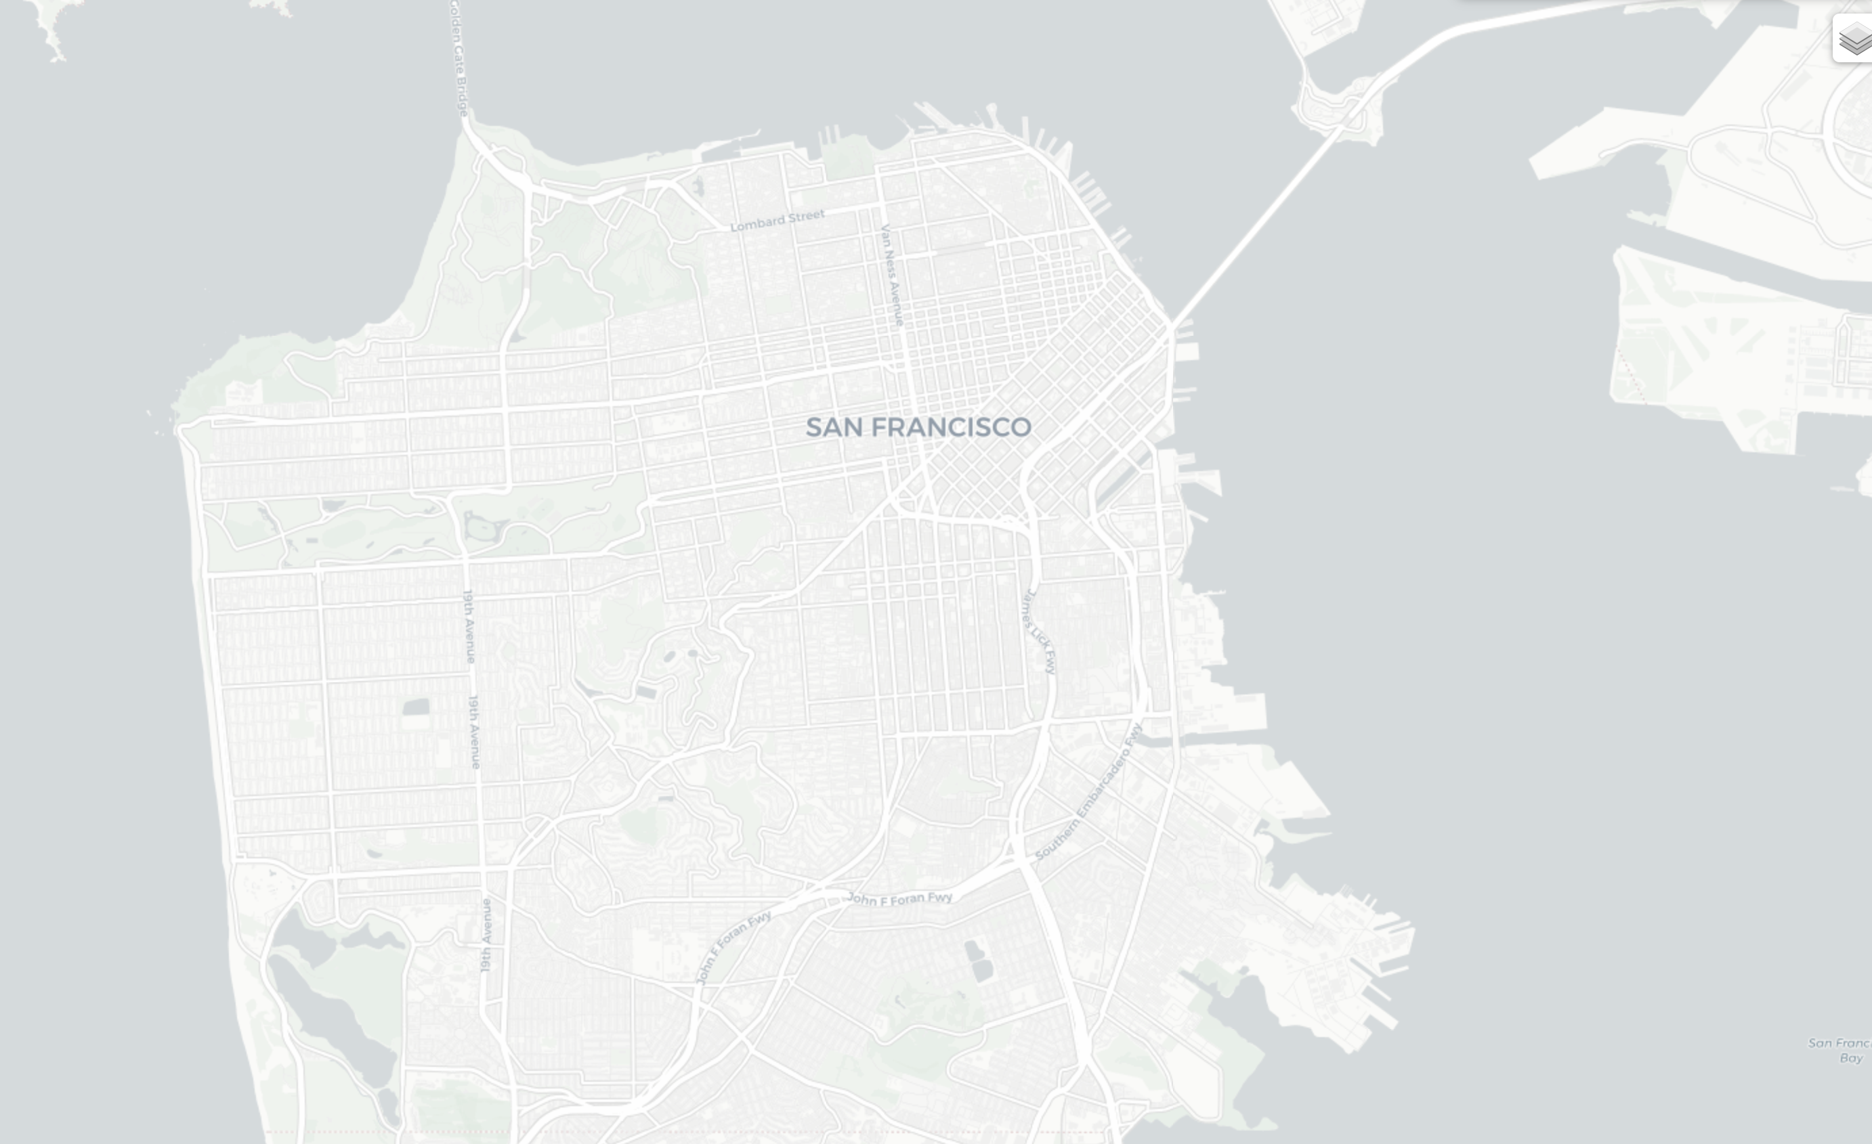
San Francisco
Founded: 1849
Population: 874,784 (Bay Area: 7m)
Area: 7 miles in both width and length (49 miles squared)
Fun Facts: North America’s Oldest China Town
The fortune cookie was born here
City has 50+ hills

Slide 5
What data?
Crime: SFPD Incident Report: 2018 to Present
Demographic: America Community Survey 2020 5 Year
Geological: SF Neighborhood to Census Tract
Notes:
SF Data: https://datasf.gitbook.io/datasf-dataset-explainers/sfpd-incident-report-2018-to-present

Slide 6
SFPD Crime Data
The dataset includes incident reports that have been filed as of January 1, 2018 with an hourly frequency and published daily.
These reports are filed by officers or self-reported by members of the public using SFPD’s online reporting system.
Coordinates associated with incident locations provided within the dataset are anonymized and reflect the nearest intersection of each occurrence.
In 2020, 7,414 confidential flagged reports were retained by the department, or about 5.8% of the unredacted dataset. Of the 7,414 reports, 53% were also flagged as domestic violence reports.
The removal of juvenile related data in 2020 resulted in the retention of 3,581 records, or about 2.82% of the unredacted 2020 dataset.

Slide 7
Data Clean Up
$ ...1 : num [1:664280] 0 1 2 3 4 5 6 7 8 9 ...
$ incident_datetime : POSIXct[1:664280], format: "2021-07-25 00:00:00" "2022-06-28 23:58:00" "2022-03-11 10:30:00" "2021-05-15 17:47:00" ...
$ incident_date : POSIXct[1:664280], format: "2021-07-25" "2022-06-28" "2022-03-11" "2021-05-15" ...
$ incident_time : 'hms' num [1:664280] 00:00:00 23:58:00 10:30:00 17:47:00 ...
$ incident_year : num [1:664280] 2021 2022 2022 2021 2022 ...
$ incident_day_of_week : chr [1:664280] "Sunday" "Tuesday" "Friday" "Saturday" ...
$ report_datetime : POSIXct[1:664280], format: "2021-07-25 13:41:00" "2022-06-28 23:58:00" "2022-03-11 20:03:00" "2021-05-15 17:47:00" ...
$ row_id : num [1:664280] 1.06e+11 1.17e+11 1.13e+11 1.03e+11 1.17e+11 ...
$ incident_id : num [1:664280] 1057189 1165543 1130480 1030518 1165351 ...
$ incident_number : num [1:664280] 2.16e+08 2.20e+08 2.26e+08 2.10e+08 2.20e+08 ...
$ report_type_code : chr [1:664280] "II" "VS" "II" "VS" ...
$ report_type_description : chr [1:664280] "Coplogic Initial" "Vehicle Supplement" "Coplogic Initial" "Vehicle Supplement" ...
$ filed_online : logi [1:664280] TRUE NA TRUE NA NA TRUE ...
$ incident_code : chr [1:664280] "06372" "71012" "71000" "07043" ...
$ incident_category : chr [1:664280] "Larceny Theft" "Other Offenses" "Lost Property" "Recovered Vehicle" ...
$ incident_subcategory : chr [1:664280] "Larceny Theft - Other" "Other Offenses" "Lost Property" "Recovered Vehicle" ...
$ incident_description : chr [1:664280] "Theft, Other Property, $50-$200" "License Plate, Recovered" "Lost Property" "Vehicle, Recovered, Motorcycle" ...
$ resolution : chr [1:664280] "Open or Active" "Open or Active" "Open or Active" "Open or Active" ...
$ police_district : chr [1:664280] "Southern" "Out of SF" "Central" "Out of SF" ...
$ cad_number : num [1:664280] NA NA NA NA NA NA NA NA NA NA ...
$ intersection : chr [1:664280] NA NA NA NA ...
$ cnn : num [1:664280] NA NA NA NA NA NA NA NA NA NA ...
$ nhood : chr [1:664280] NA NA NA NA ...
$ supervisor_district : num [1:664280] NA NA NA NA NA NA NA NA NA NA ...
$ latitude : num [1:664280] NA NA NA NA NA NA NA NA NA NA ...
$ longitude : num [1:664280] NA NA NA NA NA NA NA NA NA NA ...
$ point : chr [1:664280] NA NA NA NA ...
$ :@computed_region_jwn9_ihcz: num [1:664280] NA NA NA NA NA NA NA NA NA NA ...
$ :@computed_region_26cr_cadq: num [1:664280] NA NA NA NA NA NA NA NA NA NA ...
$ :@computed_region_qgnn_b9vv: num [1:664280] NA NA NA NA NA NA NA NA NA NA ...
$ :@computed_region_nqbw_i6c3: num [1:664280] NA NA NA NA NA NA NA NA NA NA ...
$ :@computed_region_h4ep_8xdi: num [1:664280] NA NA NA NA NA NA NA NA NA NA ...
$ :@computed_region_n4xg_c4py: num [1:664280] NA NA NA NA NA NA NA NA NA NA ...
$ :@computed_region_jg9y_a9du: num [1:664280] NA NA NA NA NA NA NA NA NA NA ...
> 600k Observations
Missing Information
Irrelevant Information
~ 124k Duplicates
26 Columns

Slide 8
What is crime?
The reports are categorized into the following groups based on the type of incident:
47
incident_category
70
incident_subcategory
1012
incident_description
incident_category incident_subcategory incident_description
Arson Arson Arson 805
Arson of Vehicle 351
Arson with Great Bodily Injury 2
Arson, Attempted 70
Arson, Commercial Building 95
...
Weapons Offense Weapons Offense Firearm, Discharging Within City Limits 909
Weapon, Carrying Concealed 483
Weapon, Carrying Concealed with Felony or Narcotics Conviction 78
Weapon, Deadly, Imitation or Laser Scope, Exhibiting 2086
Weapon, Deadly, Possession W/ Intent To Assault 44
Notes:
Data is added to open data once incident reports have been reviewed and approved by a supervising Sergeant or Lieutenant. Incident reports may be removed from the dataset if in compliance with court orders to seal records or for administrative purposes such as active internal affair investigations and/or criminal investigations.

Slide 9
47 Categories

Slide 11
70 Subcategories

Slide 13
1012 Descriptions (incident codes)

Slide 14
Key take-away, don’t leave valuables in your car when in SF

Slide 15
When is crime?
2022-06-26
SF Pride Parade
2018 to Present (202211)
2020-03-17
COVID Lockdown
2022-08-13
???

Slide 16
Format: YYYY-MM-DD HH:MM:SS
Seasonality?
Using daily totals for a Time Series Additive Decomposition is rather noisy and doesn’t provide many insights

Slide 17
Format: YYYY-MM-DD HH:MM:SS
Seasonality
Using monthly totals makes seasonality clearer with distinct trend and yearly peaks around September and troughs in April

Slide 18
Distribution
There is an average of 291 incident per day

Slide 19
Notice anything?
There is a reporting bias to round incident minute to the top (:00) or bottom (:30) of the hour

Slide 20
Again?
There is a reporting bias to round hours to the bottom (midnight) or middle (noon) of the day with a peak around 5-6pm (commuting hours) and a lull around 5am

Slide 21
Friday seems to be the most active day of the week with Sunday the least active and a small spike on Wednesdays

Slide 22
Again, there seems to be a reporting bias to round to the first of the month

Slide 23
Seasonality?
There seems to be a peak around September and October that tappers off until April before increasing again

Slide 24
The COVID lockdown during 2020 resulted in the least number of incidents and has now rebounded higher than pre-pandemic

Slide 26
Where is crime?
SF Map with intersections

Slide 27
6367 Unique Intersections
Notes:
Hall of Justice Removed (Boardman Place)

Slide 28
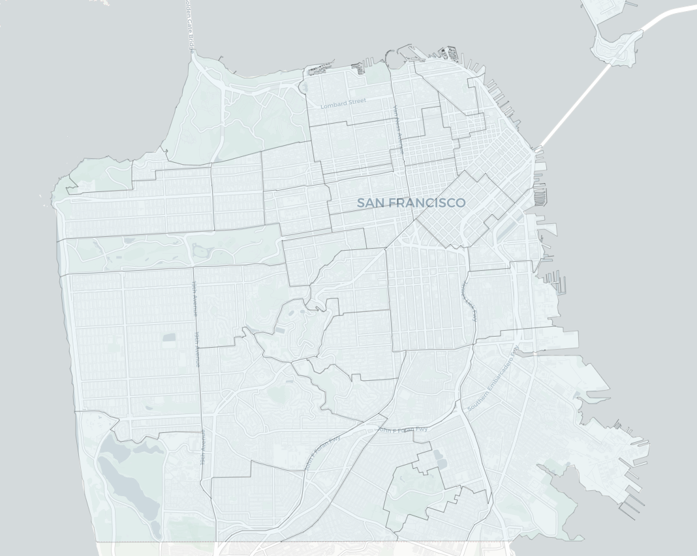
40 Neighborhoods

Slide 29
40 Neighborhoods

Slide 31
Heatmap
Heatmap of total incidents by neighborhood highlighting Tenderloin and Mission then South of Market and Financial District as highest occurrences of crime

Slide 32
Heatmap by Time?

Slide 33
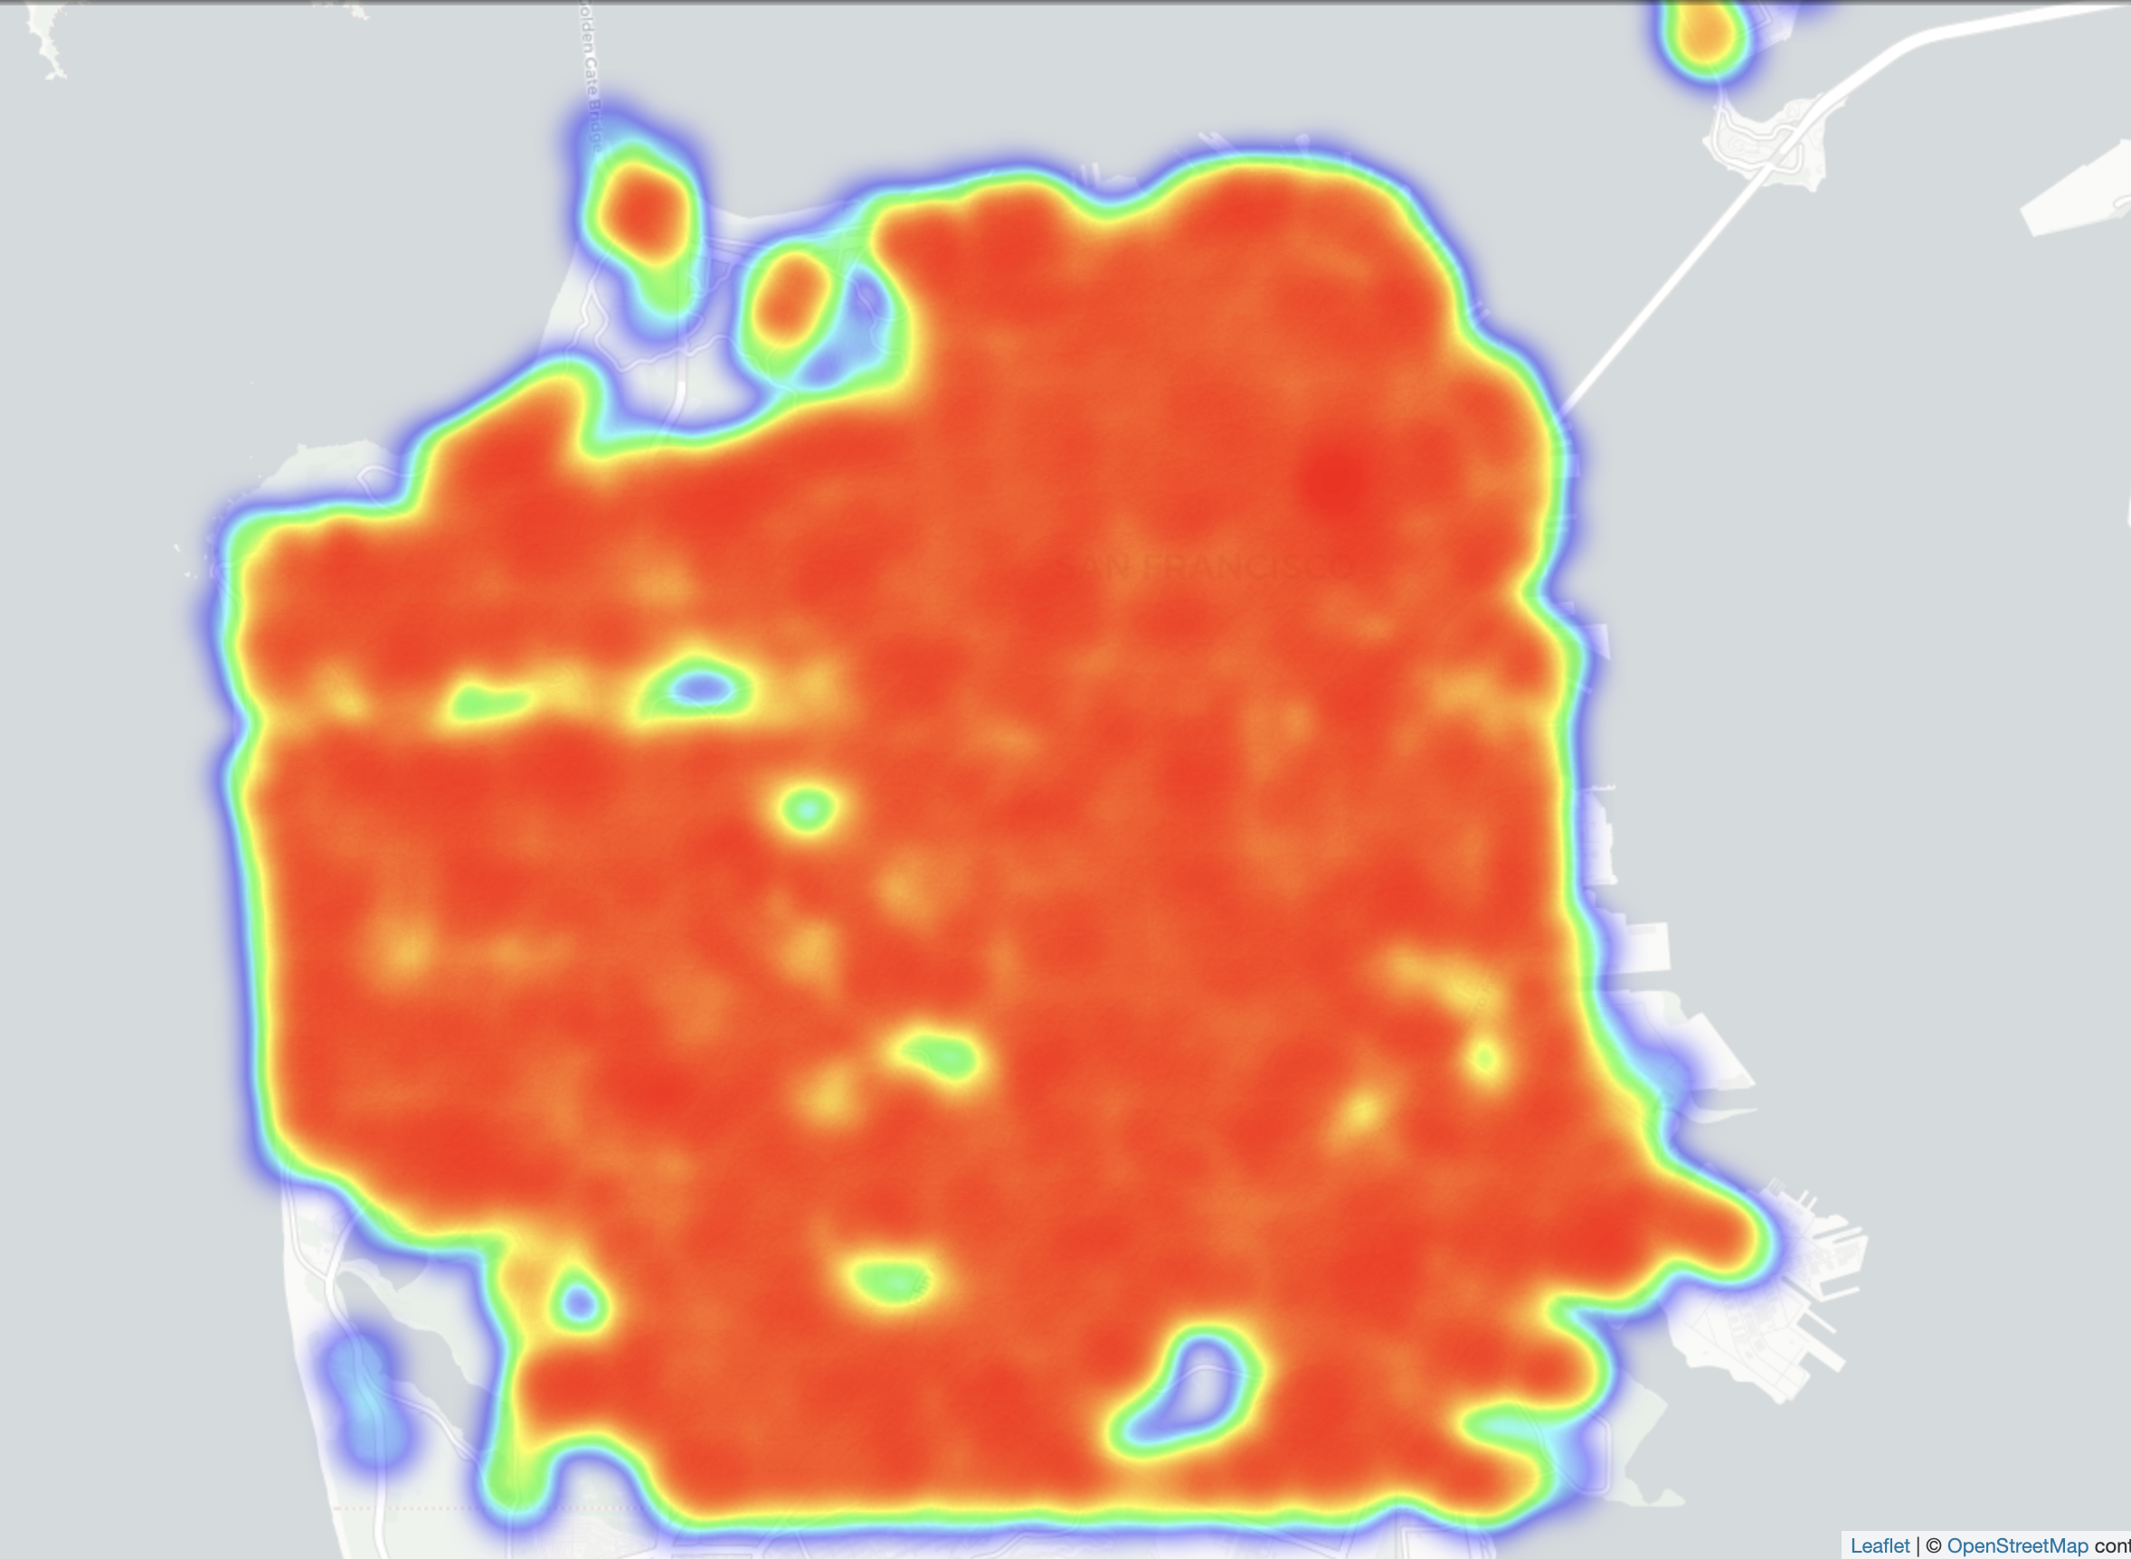
Where is crime?
Crime Category: Larceny Theft
Notes:
A little overwhelming; maybe by category or over time?

Slide 34
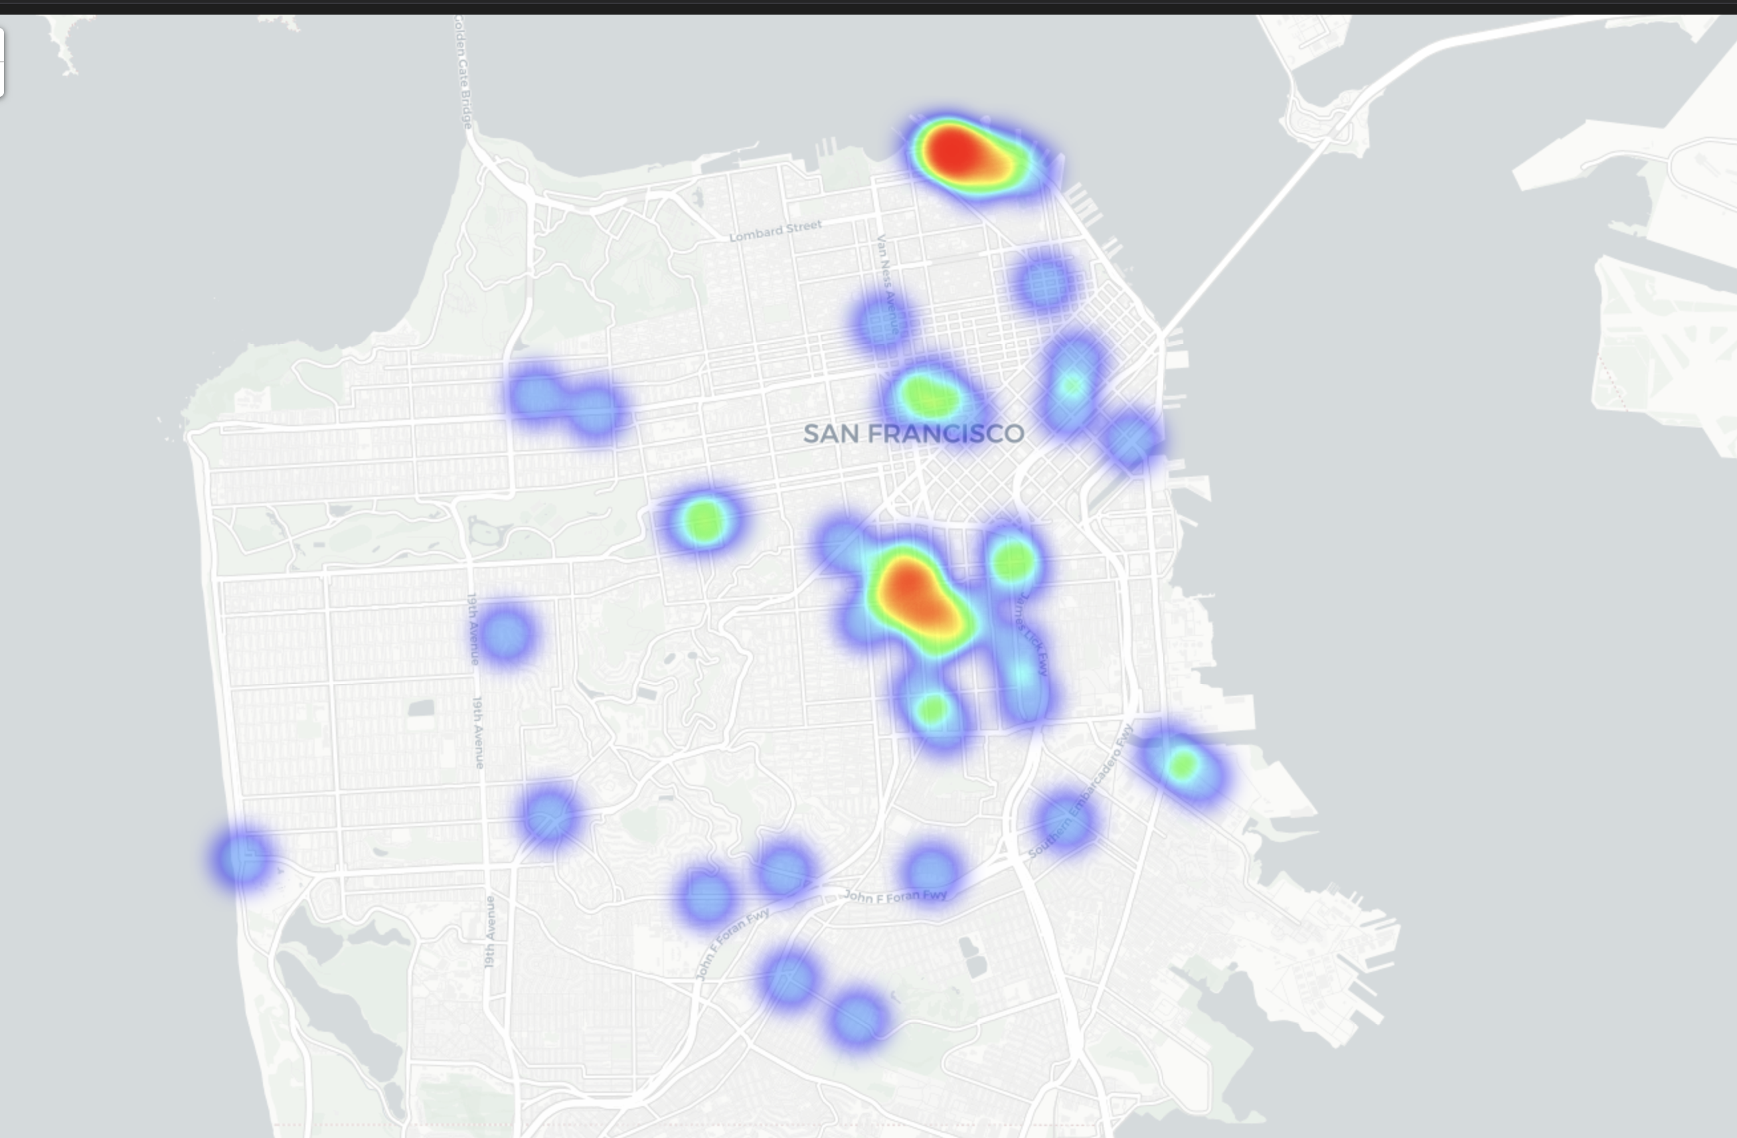
Where is crime?
Crime Category: Liquor Laws

Slide 35
Demographic Data
Economic
Median Household Income
Unemployment
Poverty
Demographic
Population
Race
Age
Any others? Weather, Holidays, Events, Disaster, etc.
Social
Educational Attainment (CHCI)
Housing
Median Number of Rooms
Rental Units
Rental Size
Median Home Price

Slide 36
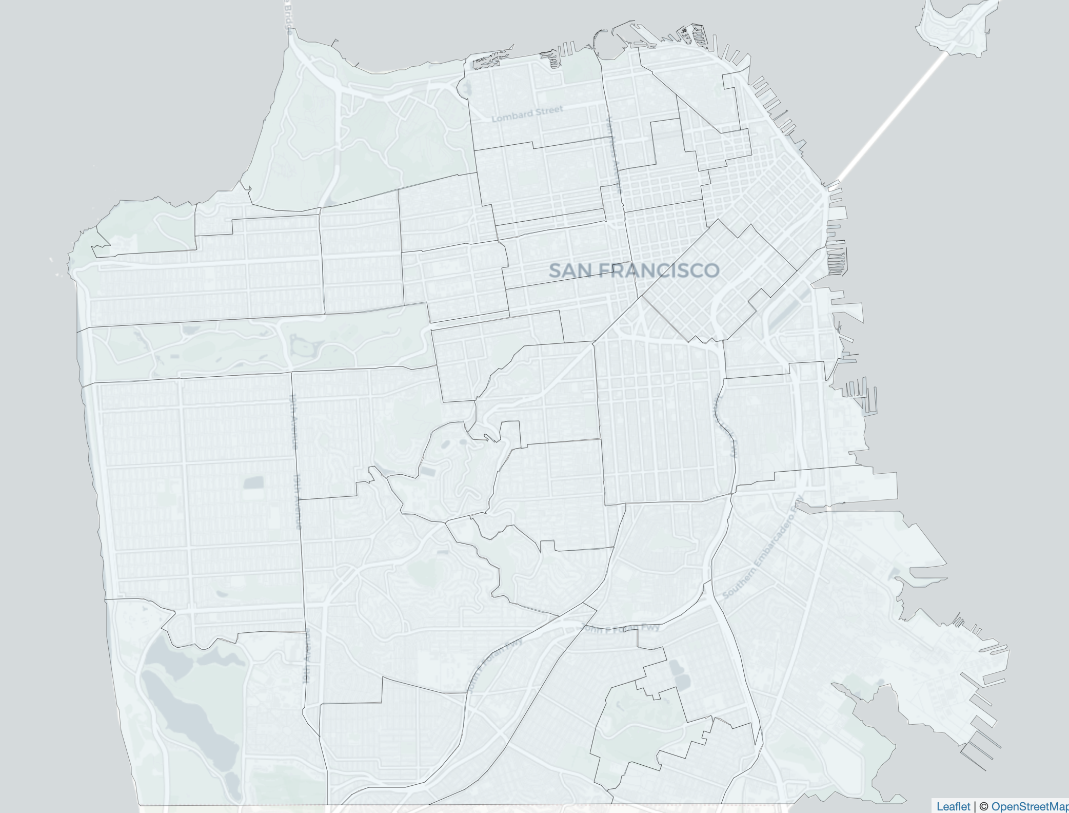
40 Neighborhoods with Crime Data

Slide 37
242 Census Tracts with Demographic Data

Slide 38
Crime / Demographic Data
sfcrime
acs5y2020
analysis_neighborhood
tract
sfnhood
neighborhood
tract

Slide 39
Insights into crime?
Dependent Variable
Independent Variables
Observations
Train / Test
Machine Learning Models

Slide 40
OLS Regression Results
==============================================================================
Dep. Variable: crime_rate R-squared: 0.963
Model: OLS Adj. R-squared: 0.917
Method: Least Squares F-statistic: 21.06
Date: Wed, 23 Nov 2022 Prob (F-statistic): 9.40e-09
Time: 13:18:31 Log-Likelihood: -123.76
No. Observations: 41 AIC: 293.5
Df Residuals: 18 BIC: 332.9
Df Model: 22
Covariance Type: nonrobust
===================================================================================
coef std err t P>|t| [0.025 0.975]
-----------------------------------------------------------------------------------
const -127.3935 125.039 -1.019 0.322 -390.091 135.304
chci 0.6648 0.258 2.574 0.019 0.122 1.207
a85a -0.9544 1.453 -0.657 0.520 -4.007 2.099
a7584 0.8287 0.870 0.952 0.354 -1.000 2.657
a6574 -0.1390 1.402 -0.099 0.922 -3.083 2.806
a5564 -0.6101 1.041 -0.586 0.565 -2.797 1.577
a3554 1.9880 1.061 1.873 0.077 -0.242 4.218
a2034 0.6673 0.599 1.115 0.280 -0.591 1.925
mage 0.6508 1.440 0.452 0.657 -2.375 3.677
pop -0.0075 0.003 -2.483 0.023 -0.014 -0.001
pop_white -0.1523 0.973 -0.157 0.877 -2.196 1.892
pop_black -0.1645 1.075 -0.153 0.880 -2.423 2.094
pop_asian 0.1583 0.987 0.160 0.874 -1.916 2.233
pop_latino -0.1159 1.001 -0.116 0.909 -2.220 1.988
h_med_rooms 0.2592 3.041 0.085 0.933 -6.130 6.649
h_rental_units -0.0240 0.153 -0.157 0.877 -0.346 0.298
h_rentel_size 13.7870 10.735 1.284 0.215 -8.767 36.341
h_med_rent -0.0017 0.008 -0.230 0.821 -0.018 0.014
h_med_homeprice -1.187e-06 7.76e-06 -0.153 0.880 -1.75e-05 1.51e-05
eco_clf -0.4060 0.718 -0.565 0.579 -1.915 1.103
eco_unemp -0.2932 1.173 -0.250 0.805 -2.757 2.170
eco_med_hincome -0.0003 0.000 -2.209 0.040 -0.001 -1.42e-05
eco_poverty -0.6266 0.536 -1.169 0.258 -1.753 0.500
==============================================================================
Omnibus: 4.803 Durbin-Watson: 1.993
Prob(Omnibus): 0.091 Jarque-Bera (JB): 3.558
Skew: 0.673 Prob(JB): 0.169
Kurtosis: 3.521 Cond. No. 1.33e+08
==============================================================================
Notes:
[1] Standard Errors assume that the covariance matrix of the errors is correctly specified.
[2] The condition number is large, 1.33e+08. This might indicate that there are
strong multicollinearity or other numerical problems.
Adjusted R Squared: 91%
Positive Correlations
CHCI
Age (35 - 54)
Rental Household Size
Negative Correlations
Population
Median House Price

Slide 41
Outliers?
A very high Adjusted R-Squared seemed suspicious.

Slide 43
neighborhood | Population | incidents | crime_rate
Golden Gate Park | 32.000000 | 5353 | 167.281250
Tenderloin | 2477.166667 | 52194 | 21.070040
Financial District/South Beach | 2296.300000 | 41928 | 18.258938
Mission | 3436.705882 | 54504 | 15.859373
South of Market | 3590.285714 | 41372 | 11.523317
Bayview Hunters Point | 3498.181818 | 33660 | 9.622141
North Beach | 2386.800000 | 17545 | 7.350846
Marina | 2798.444444 | 14715 | 5.258278
Western Addition | 3185.571429 | 16501 | 5.179918
Nob Hill | 2916.333333 | 14719 | 5.047091
Russian Hill | 2605.285714 | 12594 | 4.834019
Castro/Upper Market | 3305.428571 | 15242 | 4.611202
Lincoln Park | 185.000000 | 808 | 4.367568
Chinatown | 2385.000000 | 9603 | 4.026415
McLaren Park | 153.000000 | 607 | 3.967320
Hayes Valley | 3963.600000 | 14057 | 3.546523
Pacific Heights | 2661.444444 | 9138 | 3.433474
Sunset/Parkside | 5102.437500 | 15225 | 2.983868
Potrero Hill | 2969.000000 | 8802 | 2.964635
Outer Richmond | 4158.636364 | 11903 | 2.862236
Haight Ashbury | 3836.200000 | 8494 | 2.214170
Bernal Heights | 4358.166667 | 9568 | 2.195419
Mission Bay | 4443.333333 | 9258 | 2.083571
West of Twin Peaks | 5497.857143 | 10367 | 1.885644
Lakeshore | 3592.000000 | 6530 | 1.817929
Excelsior | 5122.500000 | 8631 | 1.684919
Inner Richmond | 4550.600000 | 6936 | 1.524195
Japantown | 3624.000000 | 5492 | 1.515453
Noe Valley | 3771.333333 | 5670 | 1.503447
Outer Mission | 4929.200000 | 7365 | 1.494157
Portola | 4060.750000 | 5877 | 1.447270
Lone Mountain/USF | 4337.500000 | 6170 | 1.422478
Visitacion Valley | 3975.000000 | 5624 | 1.414843
Inner Sunset | 4758.500000 | 6539 | 1.374173
Oceanview/Merced/Ingleside | 4555.833333 | 5554 | 1.219096
Presidio Heights | 3481.666667 | 3277 | 0.941216
Twin Peaks | 4034.000000 | 2674 | 0.662866
Glen Park | 4327.000000 | 2854 | 0.659579
Treasure Island | 3184.000000 | 1901 | 0.597048
Seacliff | 2416.000000 | 763 | 0.315811
Presidio | 4073.000000 | 1070 | 0.262706
Parks have very little ACS population though a significant number of crime incidents, creating outliers
Remove Observations:
Neighborhood: Golden Gate Park
Population: 32
Incidents: 5353
Crime Rate: 167

Slide 44
Better representation with positive correlation for all races except White, Other Race, and Two Plus Races

Slide 45
Better distribution with negative correlation for younger ages (<20 years) and strong positive correlation for young adults (<45)

Slide 46
OLS Regression Results
==============================================================================
Dep. Variable: crime_rate R-squared: 0.809
Model: OLS Adj. R-squared: 0.529
Method: Least Squares F-statistic: 2.888
Date: Wed, 23 Nov 2022 Prob (F-statistic): 0.0194
Time: 13:20:11 Log-Likelihood: -82.556
No. Observations: 38 AIC: 211.1
Df Residuals: 15 BIC: 248.8
Df Model: 22
Covariance Type: nonrobust
===================================================================================
coef std err t P>|t| [0.025 0.975]
-----------------------------------------------------------------------------------
const -109.4247 57.781 -1.894 0.078 -232.582 13.733
chci 0.2230 0.129 1.727 0.105 -0.052 0.498
a85a -1.0017 0.772 -1.298 0.214 -2.646 0.643
a7584 -0.0195 1.076 -0.018 0.986 -2.314 2.275
a6574 1.1228 0.768 1.462 0.164 -0.514 2.760
a5564 0.9737 0.635 1.533 0.146 -0.380 2.328
a3554 0.5748 0.536 1.073 0.300 -0.567 1.717
a2034 0.8145 0.296 2.752 0.015 0.184 1.445
mage 1.0738 0.672 1.597 0.131 -0.359 2.507
pop -0.0022 0.002 -1.380 0.188 -0.006 0.001
pop_white -0.5874 0.523 -1.123 0.279 -1.703 0.528
pop_black 0.2051 0.505 0.407 0.690 -0.870 1.280
pop_asian -0.4314 0.500 -0.863 0.402 -1.497 0.635
pop_latino -0.0632 0.487 -0.130 0.898 -1.102 0.975
h_med_rooms -3.1406 1.551 -2.025 0.061 -6.446 0.164
h_rental_units 0.1953 0.111 1.764 0.098 -0.041 0.431
h_rentel_size 9.7535 4.980 1.959 0.069 -0.861 20.368
h_med_rent 0.0081 0.004 2.194 0.044 0.000 0.016
h_med_homeprice 1.292e-05 5.11e-06 2.531 0.023 2.04e-06 2.38e-05
eco_clf -0.4151 0.341 -1.217 0.242 -1.142 0.312
eco_unemp -0.2503 0.555 -0.451 0.659 -1.433 0.933
eco_med_hincome -1.234e-05 6.99e-05 -0.177 0.862 -0.000 0.000
eco_poverty -0.0475 0.271 -0.175 0.863 -0.626 0.531
==============================================================================
Omnibus: 1.461 Durbin-Watson: 1.923
Prob(Omnibus): 0.482 Jarque-Bera (JB): 1.160
Skew: 0.422 Prob(JB): 0.560
Kurtosis: 2.858 Cond. No. 1.36e+08
==============================================================================
Notes:
[1] Standard Errors assume that the covariance matrix of the errors is correctly specified.
[2] The condition number is large, 1.36e+08. This might indicate that there are
strong multicollinearity or other numerical problems.
Adjusted R Squared: 52%
Positive Correlations
Age (20 - 34)
Median House Price
Rental Household Size
Negative Correlations
Median Household Room

Slide 47
Next Steps
Crime is concentrated in certain locations
Crime is seasonal
A time series forecast should be possible
What other variables influence crime are there?
With some more data wrangling, there are still a lot of insights to be gained with additional models

